Slide 1
Impacts of Urban Noise
Ed Baker
Acoustic Biology Researcher Natural History Museum, London

Slide 2
What is noise?

Slide 3
Unwanted sound?

Slide 4
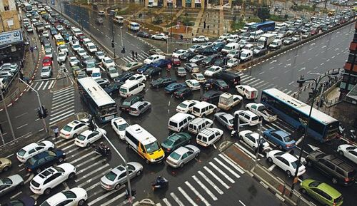

Slide 5
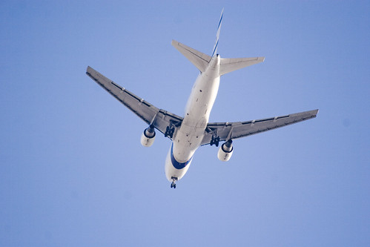
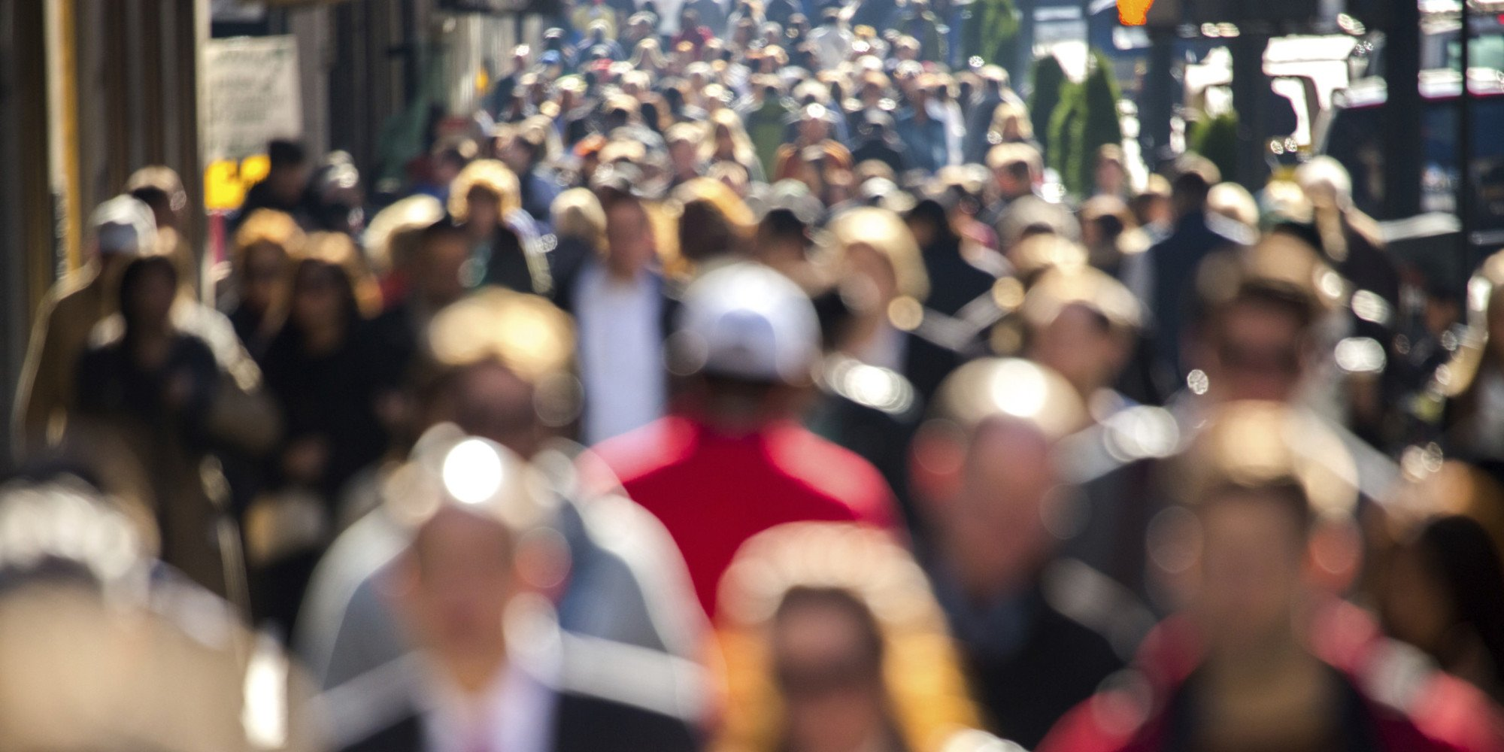
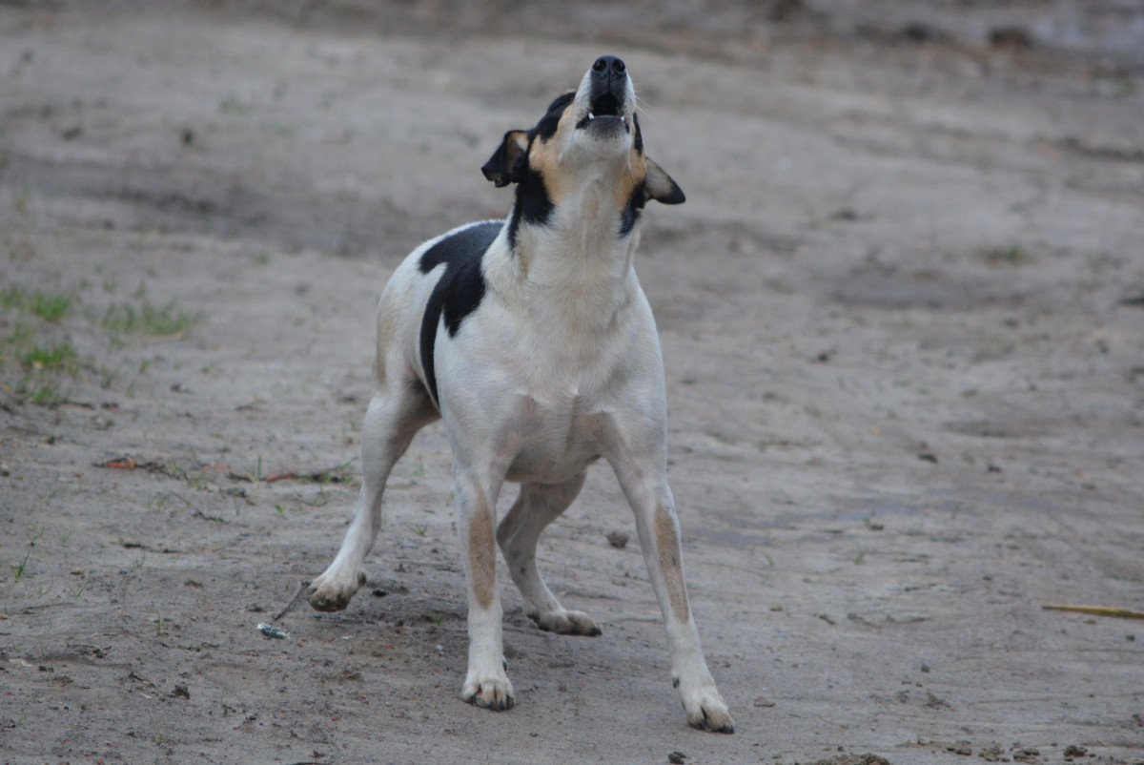
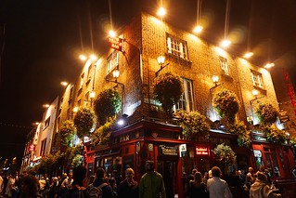

Slide 6
A working definition
Sound that is:
Unwanted
Unpleasant

Slide 7
Context dependant?

Slide 8

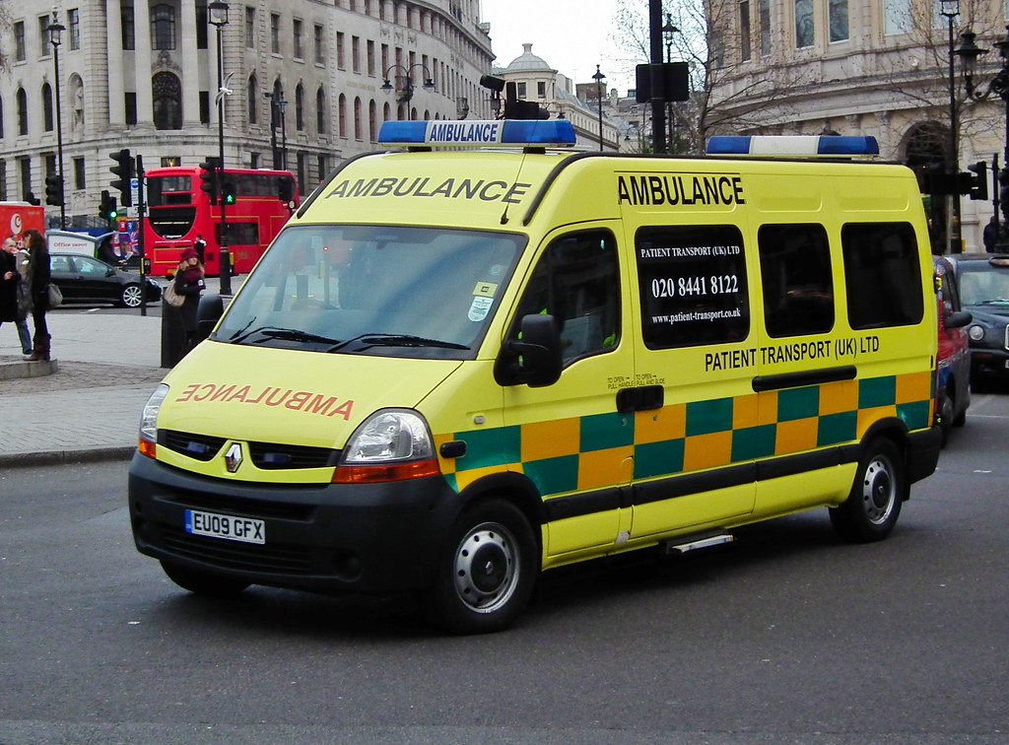

Slide 9
Not always awful?

Slide 10


Slide 11
Human centred

Slide 12
An alternative, precise definition
Data Source
Transmitter
Receiver
Data Destination
Noise Source

Slide 13


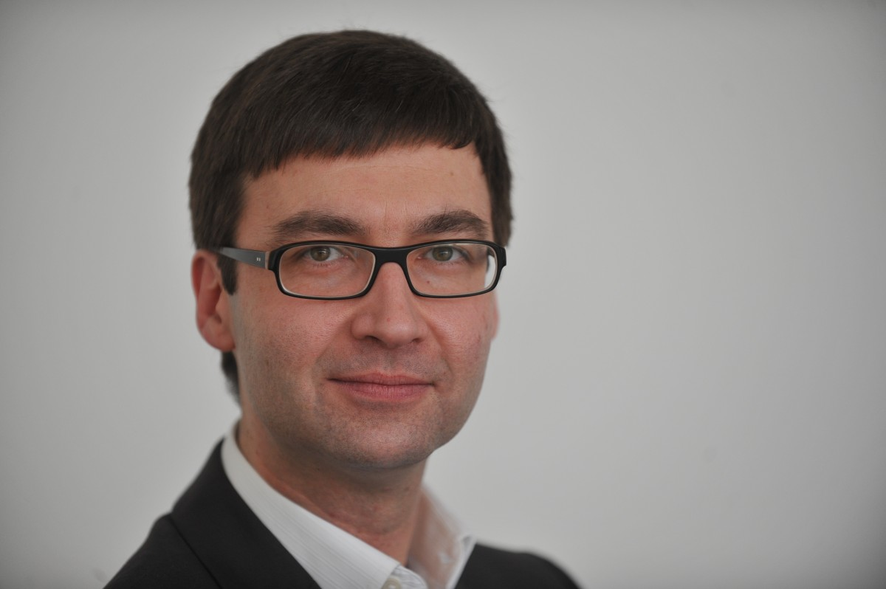
An alternative, precise definition
Data Source
Transmitter
Receiver
Data Destination
Signal
Received Signal
Noise Source
Attenuation
Interference

Slide 14
“The word communication will be used here in a very broad sense to include all of the procedures by which one mind may affect another.” – Warren Weaver

Slide 15
A working definition
Sound that is:
Unwanted
Unpleasant
Disruptive

Slide 16
What are the effects of noise?

Slide 17
On people
It is estimated that the annual social cost of urban road noise in England is £7 billion to £10 billion.
https://www.gov.uk/guidance/noise-pollution-economic-analysis

Slide 18
On people
It is estimated that the annual social cost of urban road noise in England is £7 billion to £10 billion.
sleep disturbance
annoyance
Acute Myocardial Infarction
hypertension
https://www.gov.uk/guidance/noise-pollution-economic-analysis

Slide 19
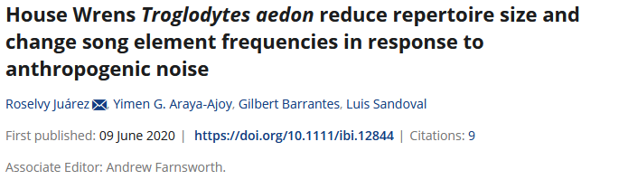
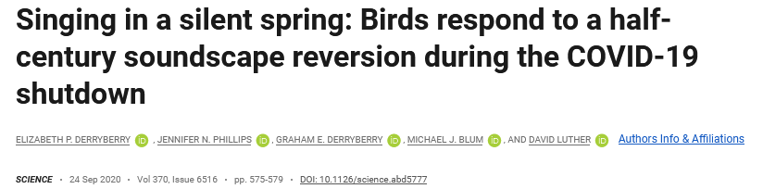
On wildlife
“This shift was especially notable because the frequency of human-produced traffic noise occurs within a range that interferes with the highest performance and most effective song. Thus, our “quiet” allowed the birds to quickly fill the most effective song space.”

Slide 20
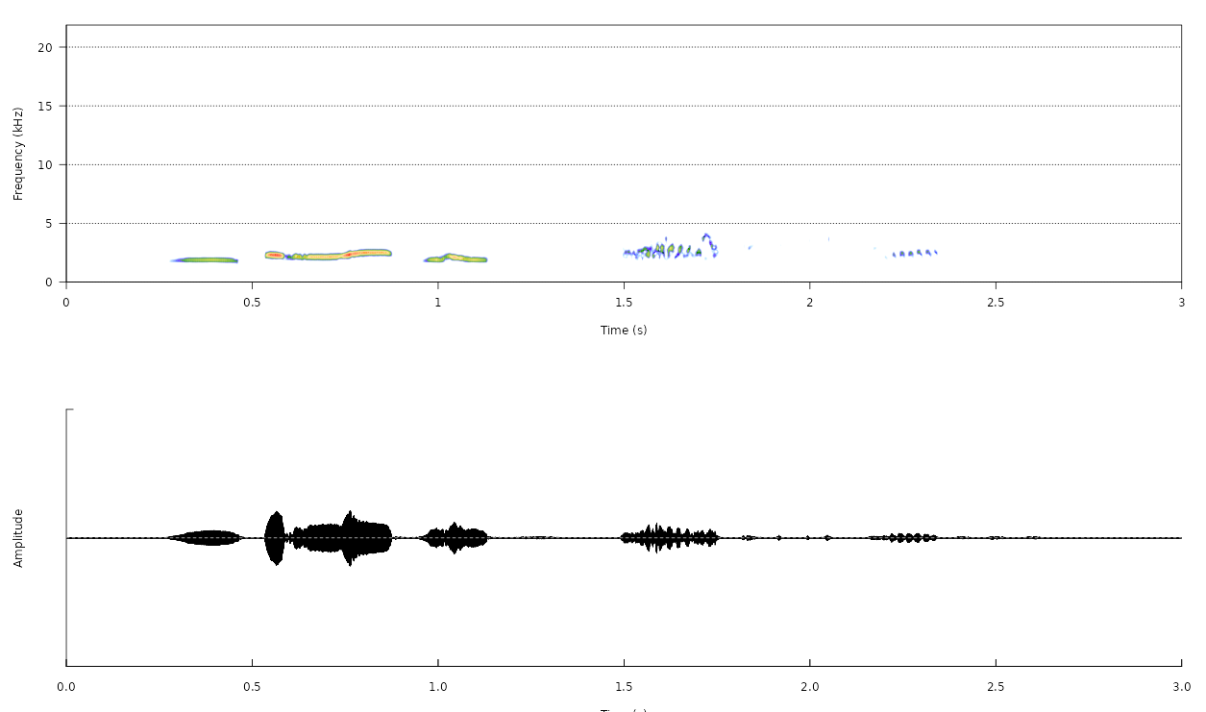
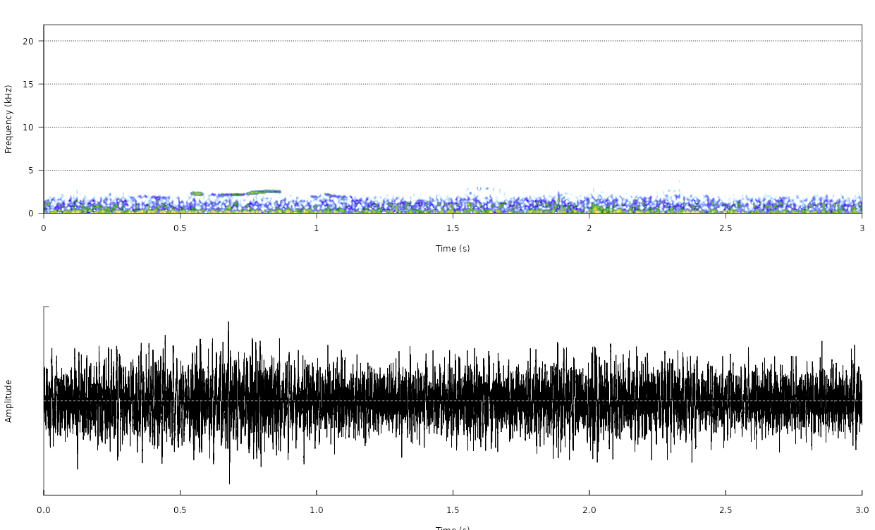
On wildlife
https://shiny.ebaker.me.uk/noise_wildlife/

Slide 21
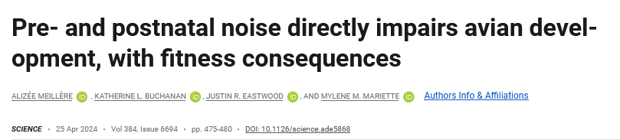
On wildlife
“… birds exposed to traffic sounds in the egg had impaired growth, shorter telomeres, and reduced production as adults. Such effects may be pervasive given the ever-present background drone of our traffic noise.”

Slide 22
What do we do about it?

Slide 23
Abatement
Noise reduction
Noise buffers

Slide 24
What’s missing?

Slide 25
What’s missing?
More-than-human evidencee base
Non-airborne sounds
Several problems – one solution

Slide 26
How does NHM study noise?

Slide 27
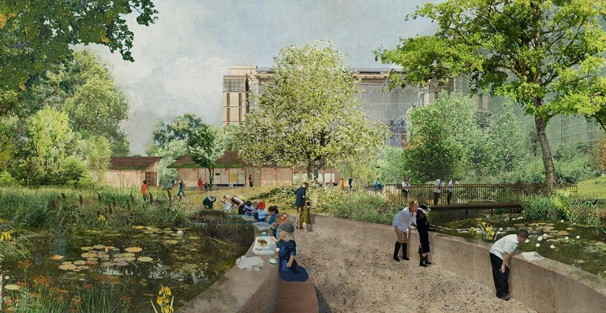
A Living Laboratory
Our gardens are a hub for urban nature identification and field survey skills

Slide 28
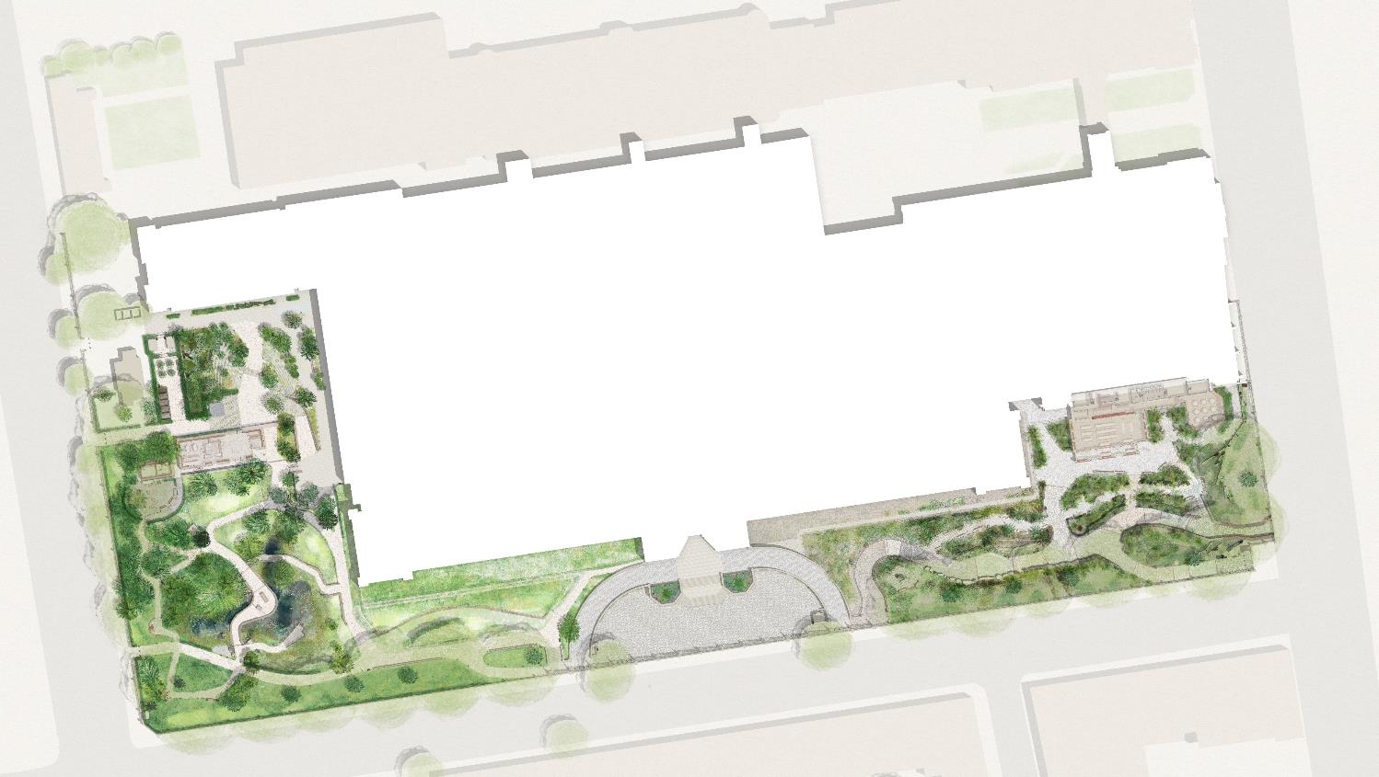
A Living Laboratory
Power-over-Ethernet locations
Long-term (intense, untargeted) monitoring plus detailed case studies of how habitat translocation, creation and restoration actions impact biodiversity
Over-specified (plenty of excess compute, transfer) – capacity to double number of devices. Testing arena for more targeted, less power-hungry devices.
Background data:
One of the most intensively studied urban sites for 25 years

Slide 29
NHM Noise
Bioacoustic monitoring that is robust in noisy environments
Propagation of sound in green urban environments
Interaction of nature and people
Make cities a bit nicer

Slide 30
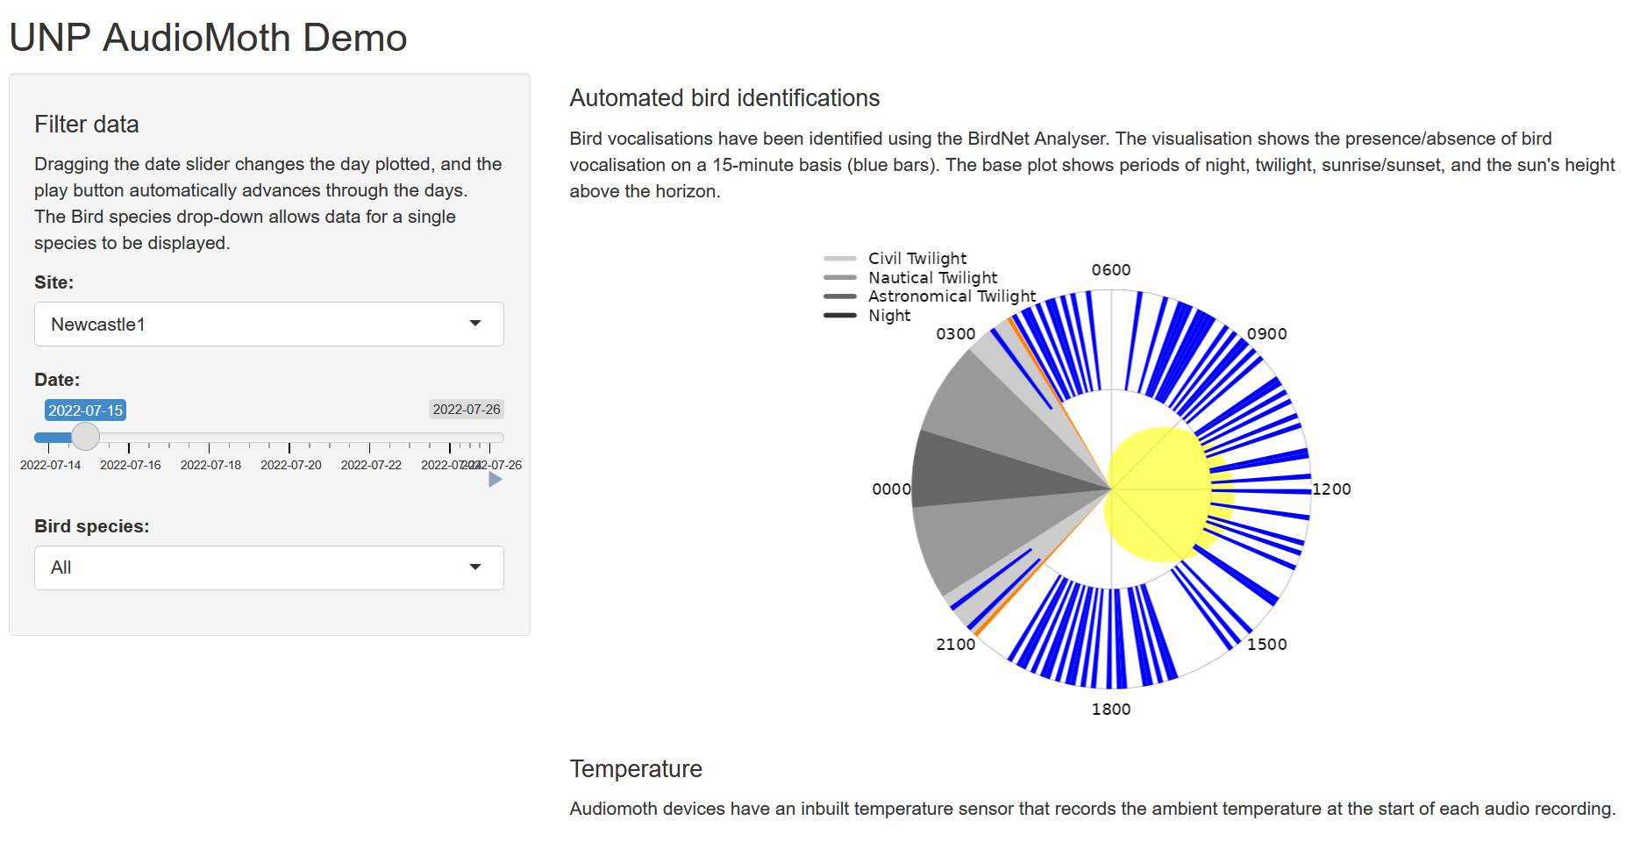

Slide 31
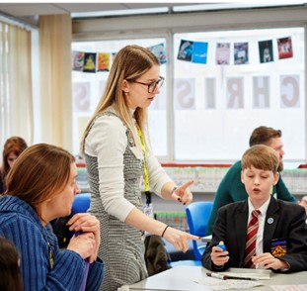
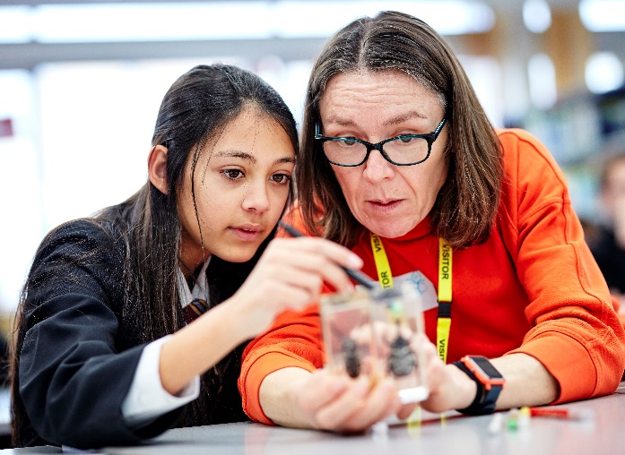

Nature Overheard
Co-design workshops with students and Museum scientists to produce a scientific question​
Nature Overheard investigates how road noise affects wildlife
Recordings from mobile devices and short online survey
nhm.ac.uk/natureoverheard

Slide 32
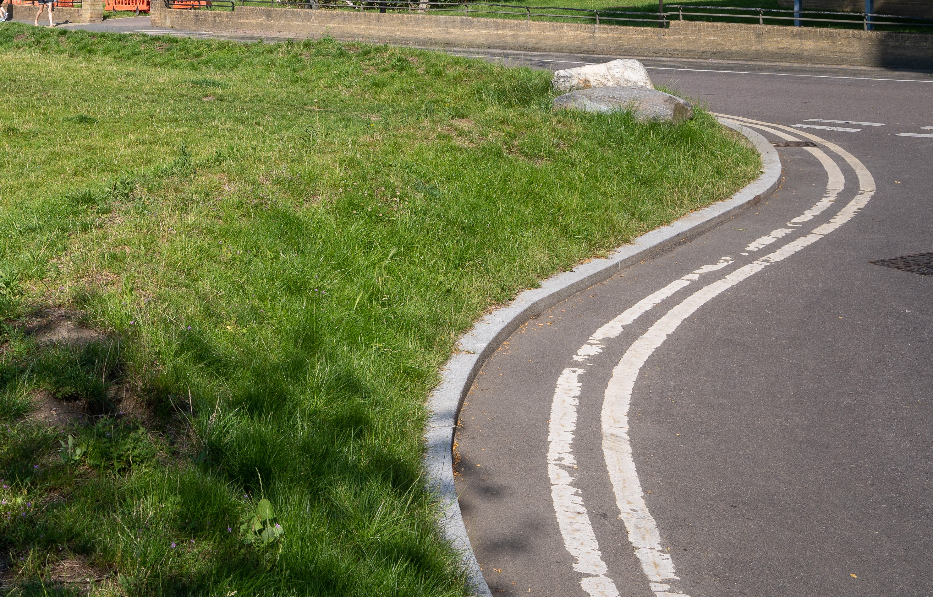
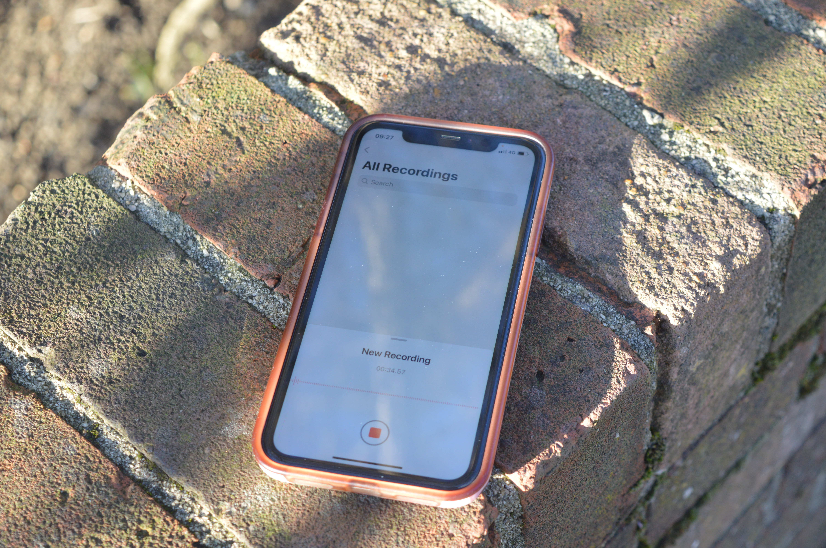


Nature Overheard
Co-created citizen science
nhm.ac.uk/natureoverheard

Slide 33
Questions?
edward.baker@nhm.ac.uk

